Slide 1
Lead Scoring Case Study
- David Livingston

Slide 2
Problem Statement
X Education needs help in selecting the most promising leads, i.e. the leads that are most likely to convert into paying customers. The company requires you to build a model wherein you need to assign a lead score to each of the leads such that the customers with a higher lead score have a higher conversion chance and the customers with a lower lead score have a lower conversion chance. The CEO, in particular, has given a ballpark of the target lead conversion rate to be around 80%.
Approach
We have build this model using Logistic regression along with RFE, to get top features and based on that we have provided recommendations to the company.

Slide 3
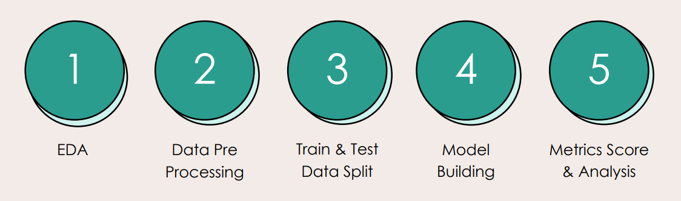
Steps Followed

Slide 4
EDA
1. Understating the Data Set:
In The given data set there was total of 9247 records with 37 attributes.
Data contains high number of missing values which we have handled by capped the null values to 40%, anything above 40% was dropped.
The country column is dropped As most of the records belongs to 'India' this variable is not significant and will not help much in classification, it is better to drop this column.
After observing the columns we found the biasing in certain columns(i.e., one class is relatively higher than other). We need to drop these columns because they lack variation.
Finally we have cut down to 9247 records and 16 attributes

Slide 5
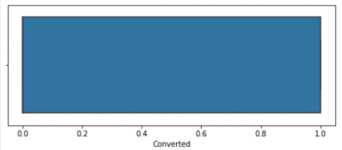
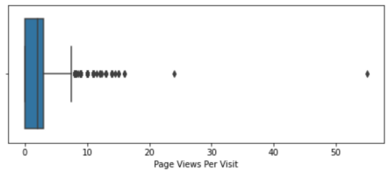
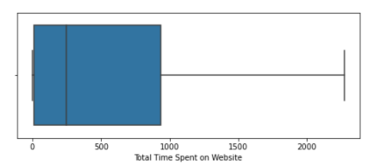
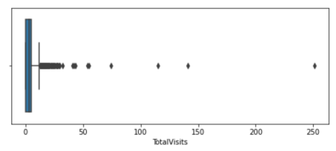
EDA
1. Outlier Check: We did some univariate analysis and then outlier treatment these were some potential outliers we did capping of 99%

Slide 6
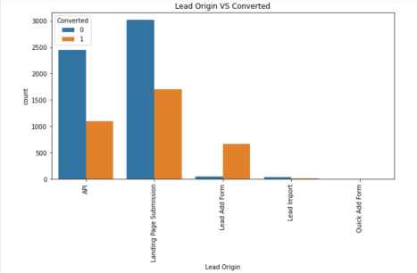
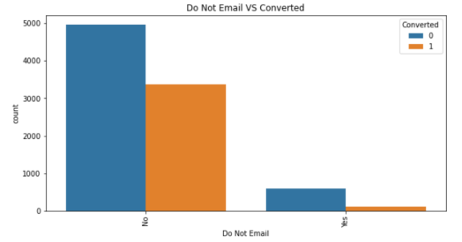
EDA
2. Visualizing The Data: We did some bivariate analysis and these are the inferences
Comparative to other lead origins categories 'Lead Add Form' category has the highest conversion ratio.
'Reference' category in 'Lead Source' column is doing good followed by 'Google' & 'Direct Traffic' in conversions.
Chance of conversion increases when the customer do not decline for Email.
'SMS Sent' category in 'Last Activity' column has highest conversion ratio followed by 'Email Opened’.
'Working Professional' seems to convert more as compared to 'Unemployed' Ones.

Slide 7
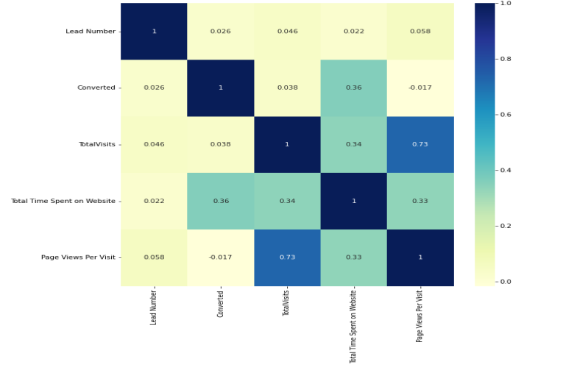
EDA
Below is the correlation matrix, total visits’ have high correlation with ‘leads number’

Slide 8
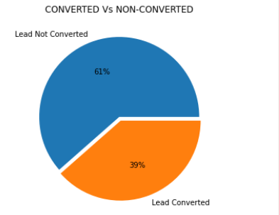
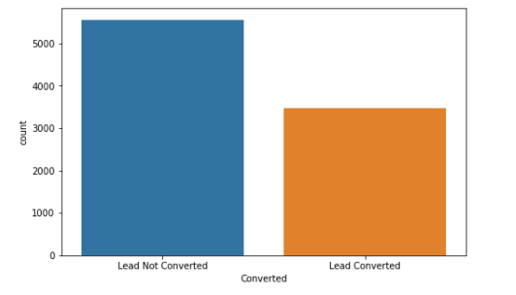
EDA
There doesn't seem to be data imbalance in the 'Target Variable'.

Slide 9
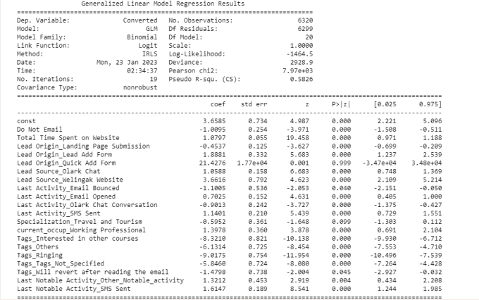
Building Mode
In The 1st Model Built, We observed 'Lead Origin Quick Add Form’ has High p-value and hence it is Insignificant.

Slide 10
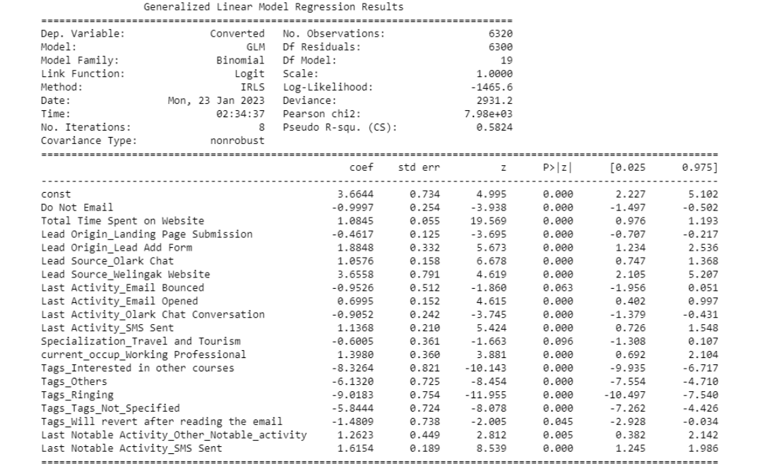
Building Mode
In The 2nd Model Built, We observed ‘Specialization Travel and Tourism’ has High pvalue and hence it is Insignificant.

Slide 11
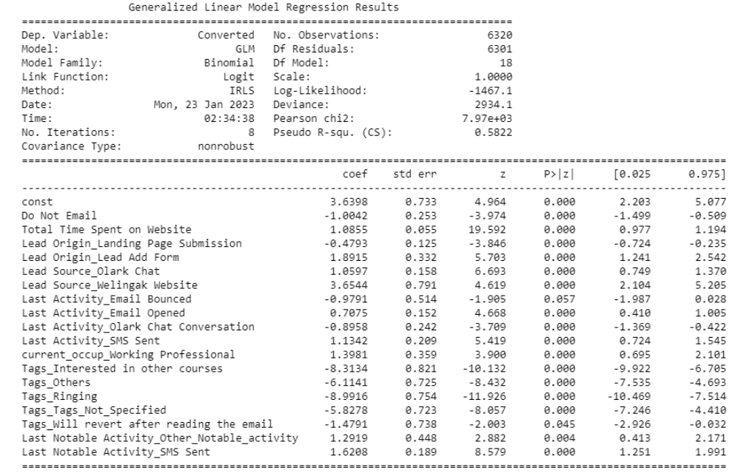
Building Mode
In The 3rd Model Built, We observed ‘Last Activity_Email Bounced’ has High p-value and hence it is Insignificant.

Slide 12
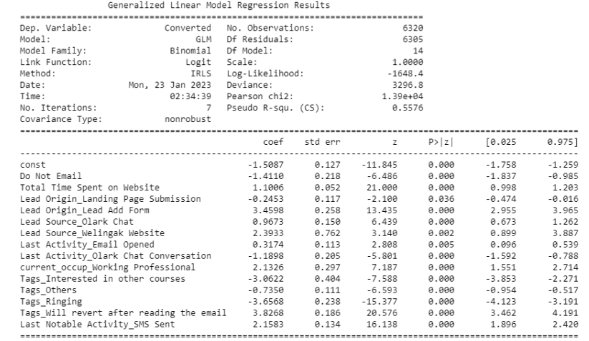
Building Mode
After multiple model build in The 7th Model Built, We observed the p-value are less than 0.05 and VIF values are less than 5. Therefore it seems that all the variables are significant and have low multicollinearity. So we can go ahead and make predictions using this model.

Slide 13
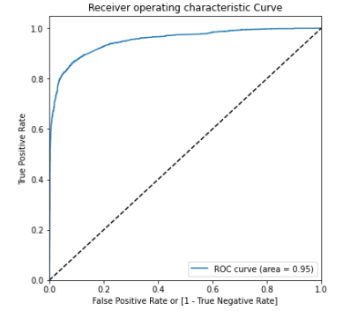
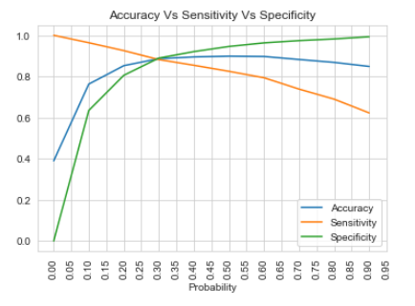
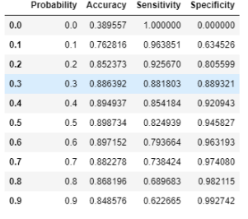
Metrics Check and Analysis
We did some analysis using roc curve, After observing 'Accuracy Vs Sensitivity Vs Specificity’ 0.3 Probability seems to be optimal cutoff.

Slide 14
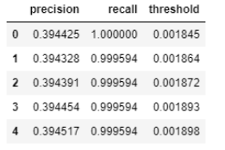
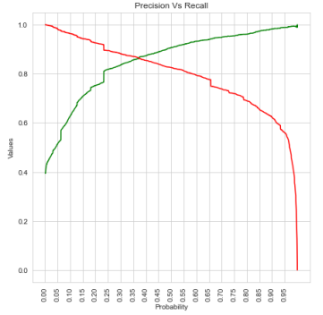
Metrics Check and Analysis
After observing 'Precision Vs Recall' and dataframe 0.37 seems to be the optimal cutoff.
After Observing both 0.3 and 0.37 Cutoffs:
0.37 Gives a bit higher accuracy score.
All the metrics seems good.
Also false positive rate is lower for 0.37 cutoff which will help in reduction of falsely predictions.

Slide 15
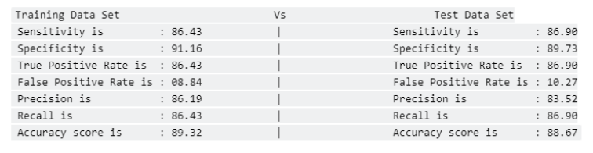
Metrics Check and Analysis
The difference b/w train and test data's performance metrics is under 3%. This means that the final model did not overfit training data and is performing well.
High Sensitivity will make sure that all possible leads who are likely to convert are correctly predicted, where as high Specificity will ensure that the leads that are on the brink of the probability of getting converted or not are not selected.
Based on the business requirement, we can increase or decrease the probability threshold value which in turn will decrease or increase the Sensitivity and increase or decrease the Specificity of the model as required.

Slide 16
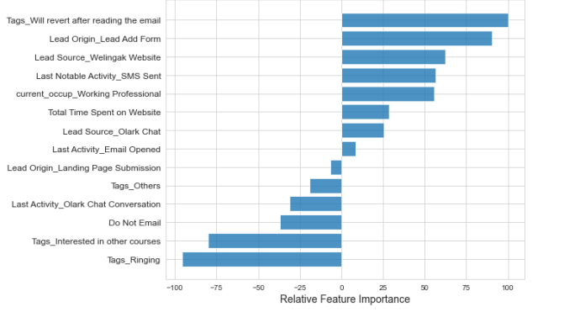
Metrics Check and Analysis
The Top 3 Factors which can help in generating more successful leads:
Tags Will revert after reading the email
Lead Origin Lead Add Form
Lead Source_Welingak Website

Slide 17
Recommendations
It Was found that the Variables that mattered the most in the potential buyers are:
• The total time spent on website
• When the last activity was on: SMS sent , olark chat and email opened
• When the Lead origin is lead add form
• Whether the customer is working professional
• When the lead source was: Direct Traffic or Welingak Website

Slide 18
Top 3 Factors which can help in generating more successful leads:
Tags_Will revert after reading the email.
Lead Origin_Lead Add Form
Lead Source_Welingak Website.

Slide 19
THANK YOU!

